Slide 1
Digit Recognition
Aryan Sefidi

Slide 2
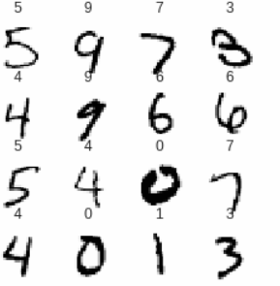
Initial Tensorflow Implementation
Single hidden layer, 10 neurons
90% accuracy on test set
Average time to predict per image: 0.196 seconds (1 GPU)

Slide 3
Attempted CUDA Implementation Lots of pain, seg-faults, and learning
Spent longer than I should have learning how to read values in from CSVs
Realized I should have just hardcoded variables
Eventually that portion worked, but no good results from CUDA matrix multiply

Slide 4
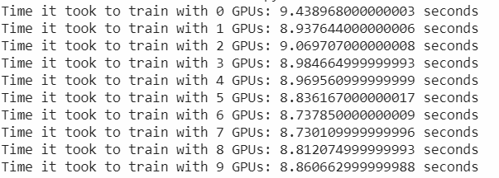
Training Speed
Google Colab
Laptop
CPU: 13.9 s
GPU: 12.8 s

Slide 5
GPU vs CPU-Only Feed Forward
Google Colab
GPU: 0.1982 s
CPU Only: 0.2795 s
Laptop
GPU: 0.005 s
CPU Only: 0.015 s

